Slide 1
History of Kotlin
Developed in 2011 by Jetbrains.
Development lead Andrey Breslav has said that Kotlin is designed to be an industrial-strength object-oriented language, and a "better language" than Java, but still be fully interoperable with Java code, allowing companies to make a gradual migration from Java to Kotlin
Kotlin v1.0 was released on February 15, 2016. This is considered to be the first officially stable release and JetBrains has committed to long-term backwards compatibility starting with this version.
At Google I/O 2017, Google announced first-class support for Kotlin on Android.

Slide 2
Basic Overview of Kotlin
High level strongly statically typed language that combines functional and technical part in a same place
Easy To setup
Namespace declaration
Kotlin allows developers to declare the functions at the top level. However, whenever the same function is declared in many places of your application, then it is hard to understand which function is being called.
No Static Declaration
Kotlin does not have usual static handling modifier like Java, which can cause some problem to the conventional Java developer.
Kotlin compiles to JVM bytecode or JavaScript

Slide 3
Basic Building Blocks of Kotlin
Only one type ‘Var’
var text = “Hello”
var text = 3
Inheritance
open class ABC {
fun think () {
print("Hey!! i am thiking ") }}
class BCD: ABC() { // inheritence happend using default constructor }

Slide 4
Basic Building Blocks of Kotlin
Kotlin
Java
Constructor
class Person(var FirstName: String, var age: Int) {
// class body
}
Exception Handling
fun main(args: Array<String>) {
try {
var myVar = 12
var v = "Tutorialspoint.com"
v.toInt();
} catch(e:Exception) {
e.printStackTrace();
} finally {
println("Exception Handeling in Kotlin"); }}
Constructor
Public class Person {
String FirstName,int age;
Person(String FirstName, Int age){
this.FirstName = FirstName , this.age = age; } }
Exception Handling
public static void main(String[] args) throws FileNotFoundException, IOException {
try{
testException(-5);
testException(-10);
}catch(FileNotFoundException e){ e.printStackTrace();
}finally{
System.out.println("Releasing resources");
}}
Notes:
Constructor : In kotlin there’s no need of making explicit constructor like in java
Exception handling : Same with slight syntax differences

Slide 5
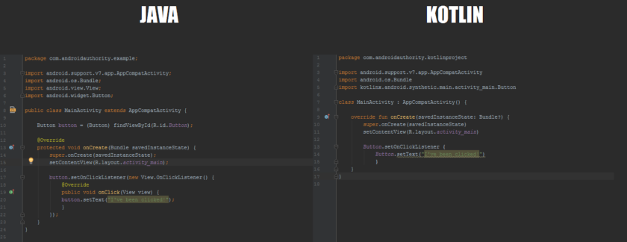
Reasons to use Kotlin
Interoperable with java
reduces boiler plate code
Notes:
Interoperable means you can use java libraries and java commands in Kotlin
Boiler plate means lines of code that you keep having to include which don’t actually add to the function of your code

Slide 6
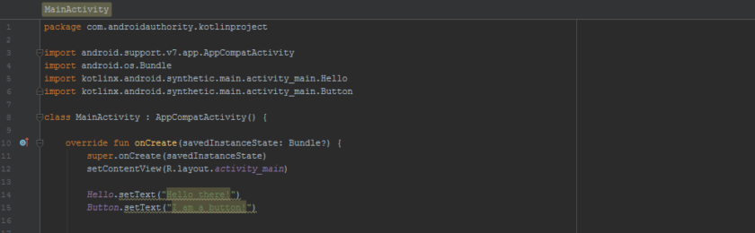
Reasons to use Kotlin
The Synthetic extension
Notes:
example is ‘Synthetic’, an extension that allows you to completely do away with typing findViewByID. Add one line of code and you’ll be able to access views directly with no need to use their IDs.

Slide 7
Reasons to use Kotlin
No semi-colons
No overhead
No more Null pointer Exceptions
var a: String = "abc"
a = null // compilation error
var b: String? = "abc"
b = null // ok
print(b)
We have to declare it a nullable by ‘?’ otherwise it would be
Notes:
No overhead means Writing an app in Kotlin versus Java will not incur any overhead: your app will be no slower and no larger than it would be otherwise

Slide 8
Reasons to use Kotlin
FP-friendly (Lets you program in functional style but does not force you )
fun main(args: Array<String>) {
println(MyFunction("tutorialsPoint.com"))
}
fun MyFunction(x: String): String {
var c:String = "Hey!! Welcome To ---"
return (c+x)
}
OO at core
Simple classes
Nested classes
Inner classes
Anonymous classes

Slide 9
Reasons to use Kotlin
*Concise
Java
Kotlin
class Book {
private String title;
private Author author;
public String getTitle() {
return title; }
public void setTitle(String title) {
this.title = title;}
public Author getAuthor() {
return author;
}
public void setAuthor(Author author) {
this.author = author;}
}
data class Book(var title: String, var author: Author)

Slide 10
Future of Kotlin
It’s named a first-class language by Google. So it can be said that Kotlin will have more and more influence among developers every year.
Kotlin Creators currently working on applying certain agile development principles, including continuous delivery, to Kotlin’s development to make sure the language keeps up with industry challenges.
Google’s official support for Kotlin as a language for Android development also guarantees that we’ll hear more about it in the future.
Once developers started using Kotlin, they came across the fact that using a modern language made their work processes more efficient and their minds more creative.
Several businesses recently have shown their support towards Kotlin by embracing it for Android app development

